Slide 1
Jerry Reeves MD Vicky Kolar
Corporate Vice President Medical Affairs Nevada
Susan Yates-Miller, Carrie Beck
Oregon

Slide 2


HealthInsight
Quality Innovation Network-Quality Improvement Organization (QIN-QIO)
CMS Quality Strategy:
  Eliminating disparities
  Strengthening infrastructure and data systems
  Enabling innovation
  Fostering learning organizations
Source: Quality Improvement Organizations. 2014. About QIN-QIOs, QIO Program Fact Sheet. Accessed March 20, 2017: qioprogram.org/about/why-cms-has-qios
Notes:
Rebekah
First a brief introduction to HealthInsight. HealthInsight is the Quality Innovation Network-Quality Improvement Organization (QIN-QIO) serving Nevada, New Mexico, Utah, and Oregon. There are 14 QIN-QIOs that bring Medicare beneficiaries, providers, and communities together in data-driven initiatives that increase patient safety, make communities healthier, better coordinate post-hospital care, and improve clinical quality. QIN-QIO work is grounded in principles aligning with the goals of the Centers for Medicare & Medicaid Services (CMS) Quality strategy:
eliminating disparities;
strengthening infrastructure and data systems; and
enabling innovation; and fostering learning organizations.

Slide 3
Polling Question
Antibiotic resistance causes how much financial burden in excess direct healthcare costs annually (data from 2013)?
  $500 million
  $1 billion
  $5 billion
  $10 billion
  $20 billion
Notes:
Answer is e.
$ from:
Prolonged and costlier treatments
Extended hospital stays
Additional doctor’s visits

Slide 4
About Antibiotic Use and Resistance
Life saving antibiotics no longer work as well
Main reason: 30%-50% overuse and misuse
  Antibiotics won’t work for colds or flu
  They can cause more harm than good
    Most common reason for child emergency visits for adverse drug events (20%)
    Kill healthy gut bacteria allowing C. difficile overgrowth
  Misdiagnosis of infections is common
Use only for sensitive bacterial infections
Notes:
Fatal multiply resistant infection in Reno
30% misdiagnosis rate for cellulitis
Seek first to understand whether the infection is bacterial and sensitive to antibiotic chosen
Convenience and speed of treatment should not exceed caution and accuracy of treatment (Telemedicine treatment excesses)

Slide 5
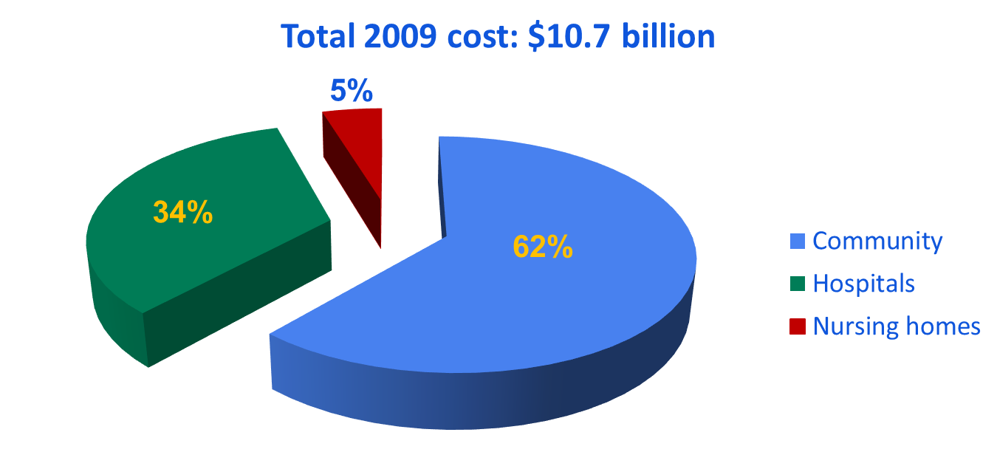
Antibiotic Expenditures in United States by Treatment Setting
Suda et al. J Antimicrob Chemother 2013; 68: 715–718
https://www.gov.uk/government/uploads/system/uploads/attachment_data/file/362374/ESPAUR_Report_2014__3_.pdf. https://www.folkhalsomyndigheten.se/pagefiles/20281/Swedres-Svarm-2014-14027.pdf.
Estimated 80-90% of antibiotic use occurring in outpatient setting
Notes:
Why should we focus on the outpatient setting? Antibiotic stewardship programs are traditionally in the inpatient setting.
This graph shows antibiotic expenditures in the United States by treatment setting, which totaled $10.7 billion in 2009.
Of that $10.7 billion, 62% of antibiotic expenditures occurred in the community or outpatient settings, followed by 34% in hospitals, and 5% in nursing homes.
Remember that most antibiotics used in the inpatient setting are much more expensive than those used in the outpatient setting, and thus the actual volume of antibiotic use in the outpatient setting is likely much higher.
[CLICK]
Based on data from other developed countries, we estimate that 80-90% of antibiotic use occurs in the outpatient setting. Illustrating why outpatient antibiotic stewardship is also critical to combating antibiotic resistance. It is clear that in order to tackle antibiotic resistance we need to improve antibiotic use across the spectrum of healthcare. We can’t leave the outpatient setting out of those efforts.

Slide 6

Polling Question
What percentage of antibiotics prescribed in 2011–2012 in outpatient settings (clinician offices and emergency departments) were found to be unnecessary prescriptions?
  3%
  5%
  10%
  20%
  30%
Notes:
Answer is e.
47 million unnecessary antibiotic prescriptions each year
It isn’t easy to find very comparable data, but we do have some from Sweden
Sweden has worked on improving outpatient antibiotics for a very long time and they have some of the lowest antibiotic prescribing rates & antibiotic resistance rates in the world
We prescribe 2.5-3 times the antibiotics that Sweden does

Slide 7
About Common Illnesses
And Symptom Relief
Chest Cold (Bronchitis)
Common Cold (Runny Nose)
Ear Infection
Flu (Influenza)
Sinus Infection
Sore Throat
Urinary Tract Infection
“Patient satisfaction with care for acute bronchitis depends most on
physician–patient communication rather than on antibiotic treatment.”
From: Annals of Internal Medicine, 2001
Notes:
Many more convenient over the counter symptom treatments are available at lower cost

Slide 8
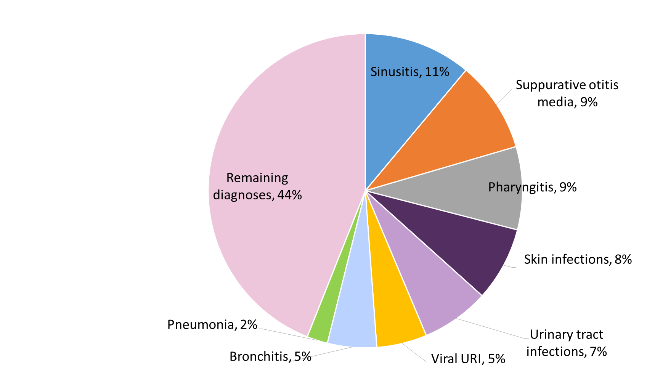
Diagnoses Leading to Antibiotics —
United States, 2010–2011
Notes:
So what are we prescribing antibiotics for?
This pie chart shows the top diagnoses leading to antibiotic prescriptions in NAMCS and NHAMCS in 2010-11, in all ages.
The number one diagnosis associated with antibiotics in the US is sinusitis, leading to 11% of all antibiotic prescriptions. The second most common was suppurative otitis media.
The third is pharyngitis, accounting for 9%, of all antibiotic prescriptions. It is important to note that this is all-cause pharyngitis. This certainly includes streptococcal pharyngitis, but also includes a lot of viral pharyngitis.
Looking at this chart, there are some easy targets for reduction in antibiotic prescribing—notably viral URI and bronchitis [CLICK], which should have no prescribing. They should not even be on this pie chart, but yet together viral URI and bronchitis lead to 10% of outpatient antibiotic prescriptions in this country.

Slide 9
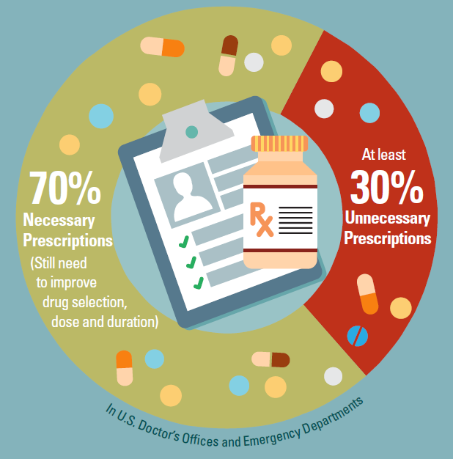
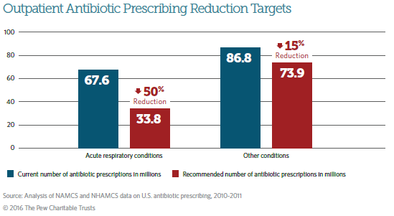
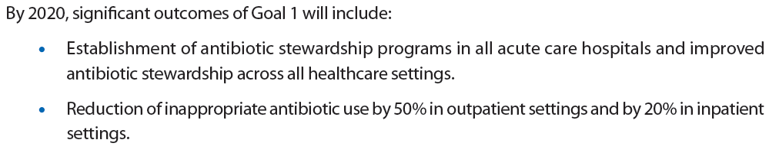
Setting National Targets:
Outpatient Antibiotic Prescribing
(CARB National Action Plan)
47 million unnecessary antibiotic prescriptions per year
Fleming-Dutra et al. JAMA 2016;315(17): 1864-1873.
http://www.pewtrusts.org/~/media/assets/2016/05/antibioticuseinoutpatientsettings.pdf; CARB Action Plan

Slide 10
Get Smart: Preserving the Power of Antibiotics
• Join us today!
HealthInsight initiative for antibiotic stewardship in outpatient settings:
  Patient education materials
  Program assessment, technical assistance with prescription protocols
  and measurement
  Professional education, learning and action network activities
Based on CDC’s Core Elements of Outpatient Antibiotic Stewardship
Aligned with practice transformation approaches
  Implementing the Core Elements is an Improvement Activity for QPP

Slide 11


Core Elements of Outpatient Antibiotic Stewardship
Sanchez GV, Fleming-Dutra KE, Roberts RM, Hicks LA. Core Elements of Outpatient Antibiotic Stewardship. MMWR Recomm Rep 2016;65(No. RR-6):1-12. https://www.cdc.gov/mmwr/volumes/65/rr/rr6506a1.htm?s_cid=rr6506a1_e
Notes:
We heard you all and now we have the Core Elements of Outpatient Antibiotic Stewardship, which were published in the Morbidity and Mortality Weekly Report (or MMWR) Recommendations and Reports, last week, on November 11.
These Core Elements provide a framework for improving antibiotic prescribing by outpatient clinicians and within facilities that routinely provide antibiotic treatment.

Slide 12
CDC Core Elements
2014 2015 2016

Slide 13

What Are the Core Elements?
Commitment: demonstrate dedication to and accountability for optimizing antibiotic prescribing and patient safety
Action for policy and practice: implement at least one policy or practice to improve antibiotic prescribing, assess whether it is working, and modify as needed
Tracking and Reporting: monitor antibiotic prescribing practices and offer regular feedback to clinicians or have clinicians assess their own antibiotic use
Education and Expertise: Provide educational resources to clinicians and patients on antibiotic prescribing and ensure access to needed expertise on antibiotic prescribing
https://www.cdc.gov/getsmart/community/improving-prescribing/core-elements/core-outpatient-stewardship.html
Notes:
What are the 4 Core Elements of outpatient antibiotic prescribing?
First is Commitment: which means to demonstrate dedication to and accountability for optimizing antibiotic prescribing and patient safety;
Next is Action for policy and practice: to implement at least one policy or practice to improve antibiotic prescribing, assess whether it is working, and modify as needed;
After that is Tracking and Reporting: which means to monitor antibiotic prescribing practices and offer regular feedback to clinicians or have clinicians assess their own antibiotic use;
And finally is Education and Expertise: to Provide educational resources to clinicians and patients on antibiotic prescribing, and ensure access to needed expertise on antibiotic prescribing.
Now we will go through each element in detail. For each, I will describe the element and then highlight interventions aimed at clinicians, including those in small or solo practice, and then interventions aimed at the clinic or health system leadership levels. We organized the document this way in order to make it easier for clinicians in small practices to find those interventions that are pertinent to their setting, and for leadership of bigger organizations to find those interventions that may need the infrastructure of a larger clinic or system to accomplish.
In order to meet each Core Element, only one suggested intervention needs to be done, from either the clinician list or the organizational leadership list. As I talk about each list, I will talk about the interventions under the clinician section or under the organization section, but that being said, we hope that clinicians and health systems will strive to implement many of the interventions over time from both lists, whichever makes the most sense for your practice.
(language updated from final proof Oct 27 2016)

Slide 14
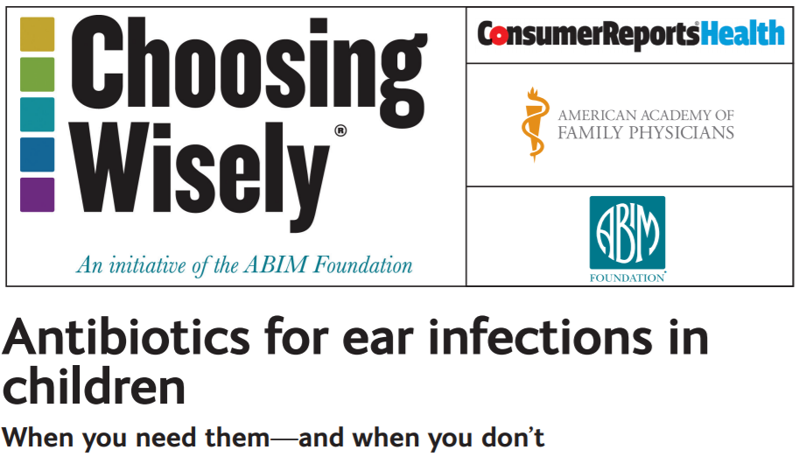
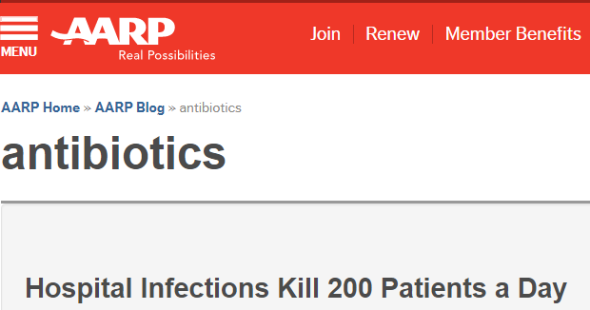

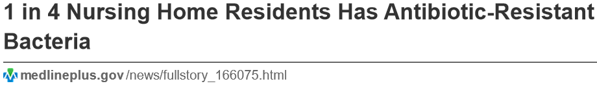
Aiming for Partners

Slide 15
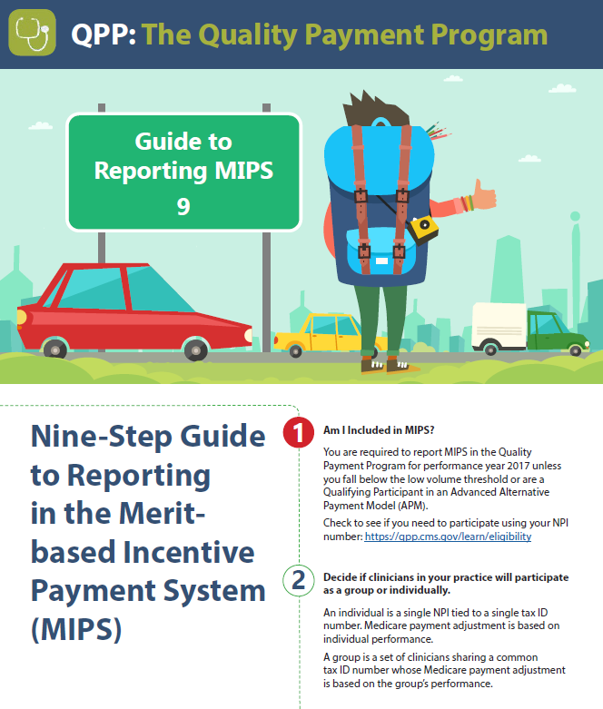
MIPS and QPP
http://healthinsight.org/files/Quality%20Payment%20Program/Understanding%20the%20Quality%20Payment%20Program/MIPS%209%20steps%206-9-17.pdf
Notes:
Please add hyperlink: http://healthinsight.org/files/Quality%20Payment%20Program/Understanding%20the%20Quality%20Payment%20Program/MIPS%209%20steps%206-9-17.pdf

Slide 16

Get Smart Tools and Resources
Commitment poster for
Core Element 1
Resources from
CDC and state coalitions
Technical assistance
for implementing the
Core Elements
healthinsight.org/getsmart

Slide 17
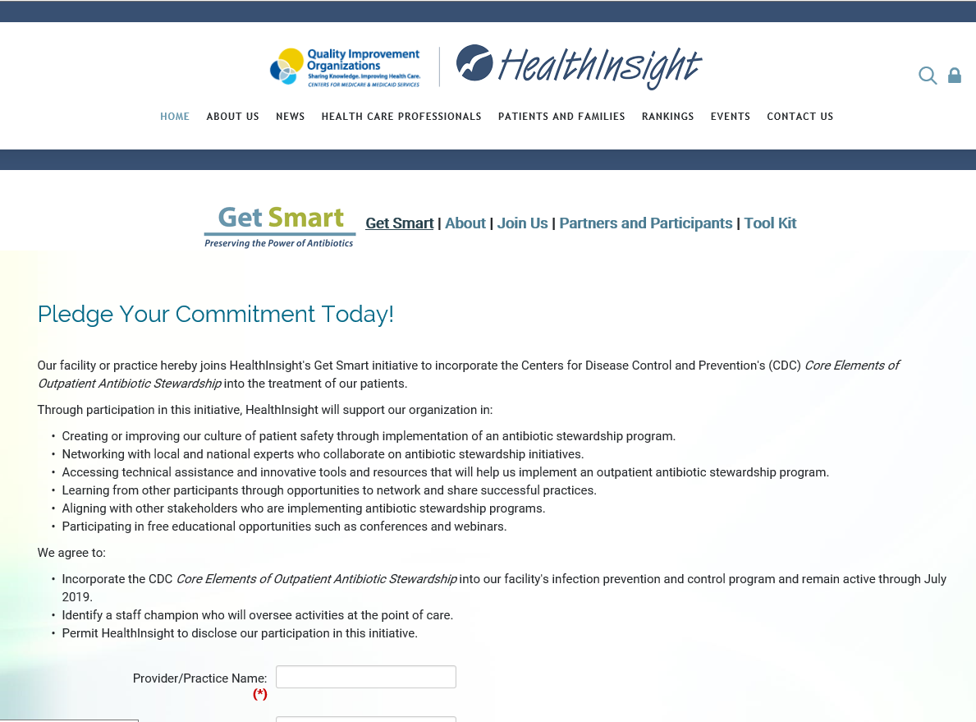
Get Smart:
Preserving the Power of Antibiotics
Notes:
To help you to work through the 4 elements, HealthInsight has developed a campaign called Get Smart: Preserving the Power of Antibiotics
In all of our 4 states we will be joining together with our partners at the Department of Health, with CMS, CDC and all of you to decrease antibiotic resistance. We will be providing materials, tools resources and educational opportunities for you to use and share to prevent Clostridium difficile in our communities. We have a goal of helping at least 500 outpatient settings to accomplish at least one piece of the 4 key elements by the summer of 2019. Please Join us…….

Slide 18


Slide 19
Questions?
jreeves@healthinsight.org
vkolar@healthinsight.org

